Slide 1

MOBILE APPS DEVELOPER BANK MANDIRI
Muhamad Bayu Fadayan

Slide 2
CONTENT
Introduction​
About Task 5
Demo Application
​Summary​

Slide 3
INTRODUCTION
Saya Muhamad Bayu Fadayan (Bayu), mahasiswa tingkat akhir Ilmu Komputer di Universitas Pakuan. Saya mengikuti program Bank Mandiri Mobile Apps Developer Project Based di Rakamin untuk menambah skill, portofolio, dan belajar hal baru. Minat saya di Mobile/Android Development, khususnya Kotlin dan integrasi API.

Slide 4
TENTANG TASK 5
Output: News App “BayNews” (Kotlin + Jetpack Compose)
Data Source: NewsAPI (Base URL: newsapi.org)
v2/top-headlines (category, pageSize, apiKey)
v2/everything (q, page, pageSize, apiKey)
Fitur yang dibuat:
Headline section + list berita
Detail berita
Infinite/Endless scrolling (pagination)
Loading / empty / error state
Tambahan: Splash Screen & Profile Page
Yang dipelajari: konsumsi REST API + parsing JSON, pagination, UI list/detail, debugging & handling error network
Tantangan: pertama kali membangun project Kotlin-Compose → belajar konsep dasar Compose, state management, dan konfigurasi project (Gradle/dependency)

Slide 5
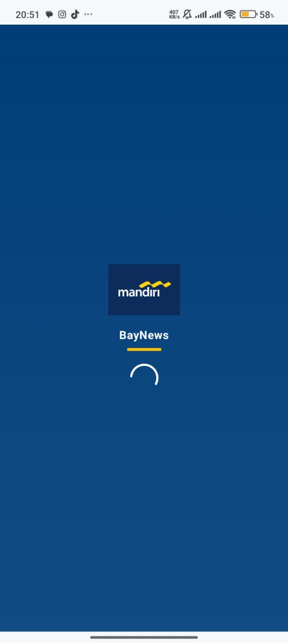
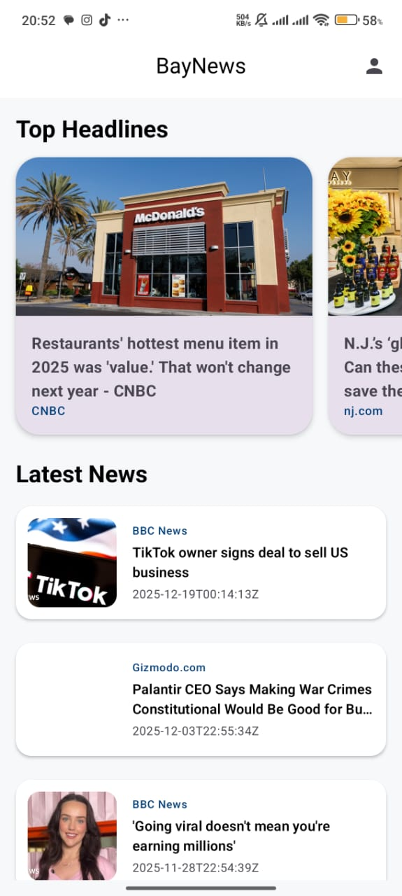
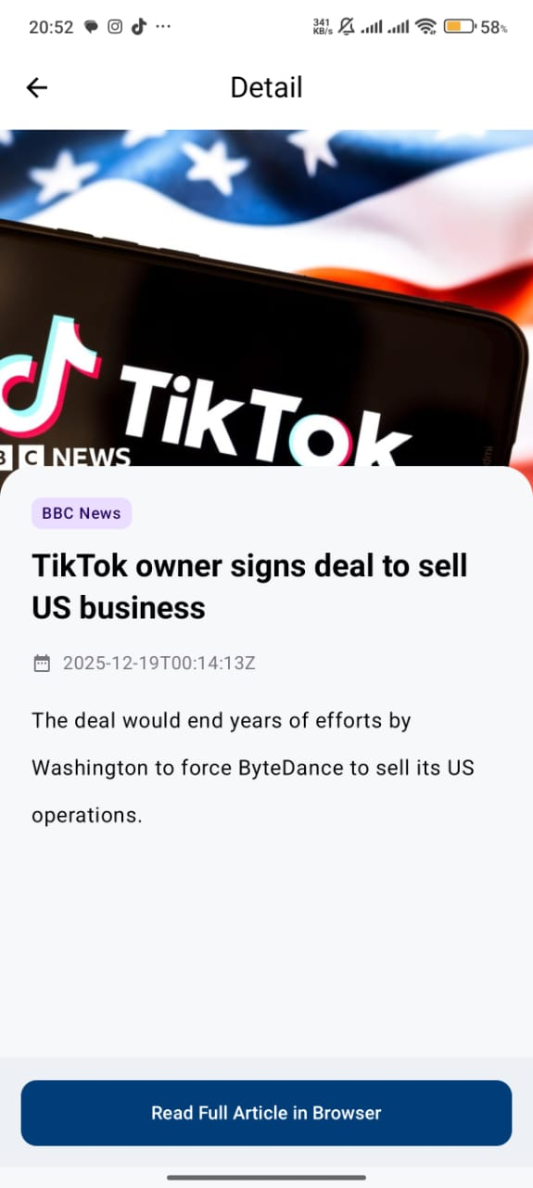
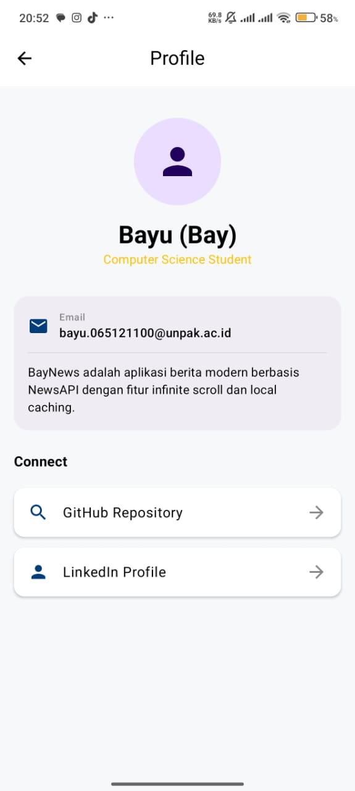
DEMO APLIKASI

Slide 6
LINK VIDEO
Link Google Drive (APK, Screenshot, dan Video):
https://drive.google.com/drive/folders/1SfMFcQx6WQi9HOh3Dogrmg-IntD5qZ9P?usp=sharing

Slide 7
THANK YOU
bayufadayan@gmail.com
0857 1604 2693
Linkedin: https://www.linkedin.com/in/muhamad-bayu-fadayan
Github: https://github.com/bayufadayan
IG: https://www.instagram.com/bayufadayan/

